Slide 1



Value Realization
Workshop #2
November 10, 2025

Slide 2
Agenda
Review Boeing Current Mode of Operation regarding dashboards
What's already configured
How do they align with AI agents and skills
Provide KPI that need to be configured
Next steps

Slide 3
ITSM Assessment Areas and Maturity
Current State Assessment
End User Experience (Portal/ Self Service)
Service Catalog
Knowledge Management
Enterprise Helpdesk
Level
Disparate portals exist, leading to fragmented user experience and disconnected fulfillment.
Built on Service Portal, not yet on Employee Center.
End user experience is very fragmented, static and not cohesive.
Level
Service Catalog Management process oversight is mature.
User experience and consumption of the catalog items for self-service/ support requests can be matured.
Level
Boeing’s Knowledge Management is highly mature and formalized
There are around 11,000 IT knowledge articles in the system, indicating a vast repository that covers a wide array of topics – a strength for self-service and support
Level
EHD supports multiple channels
Improvements are limited by fulfiller UI being outdated
Data extraction to support performance measures are manual and are performed using disparate systems.
2
4/1
4
2
Incident and Major Incident Management
Change Management
Problem Management
Intake and Release Management
Level
Boeing supports multi-channel incident intake
While the overarching incident process is consistent, each support team has the bandwidth to personalize procedures
MIM is at a higher maturity
Level
Practice is well-defined with three change types: Standard (pre-approved), Normal, and Emergency.
Changes are perceived to be the major cause of incidents
Module is significantly customized to support process
Level
Major problem management is mature, featuring structured workflows, evidence-based RCA, and clear accountability
The enterprise problem management process is inconsistent and team-driven, with low overall adoption of the problem module
Level
Boeing’s release management is thorough.
Release deployments are managed as formal events, often done after-hours or in maintenance windows.
The team is actively working on DPR, to enhance integration with ADO
3/ 3.5
2
2
3

Slide 4
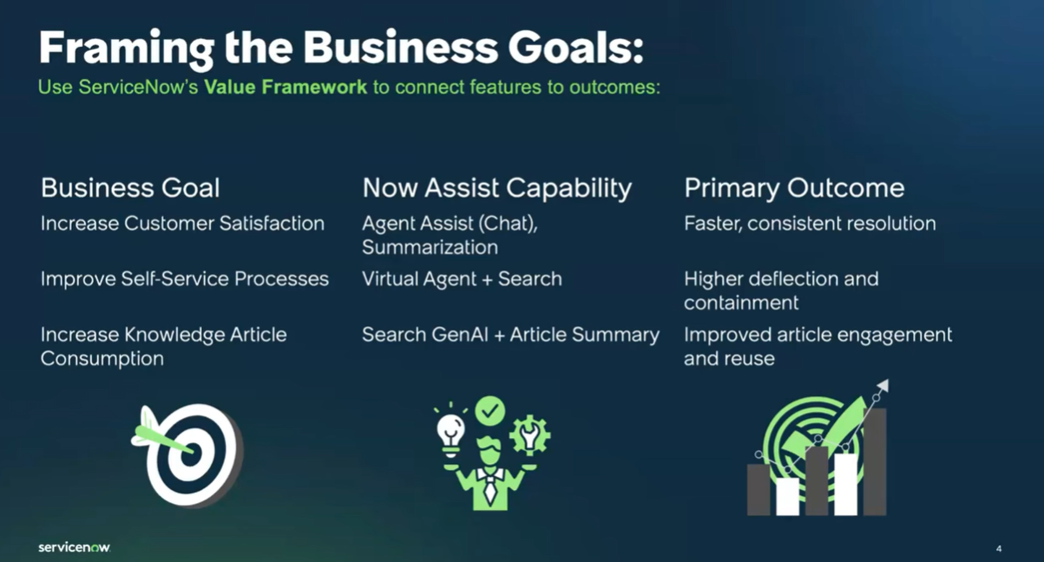
Next Steps

Slide 5
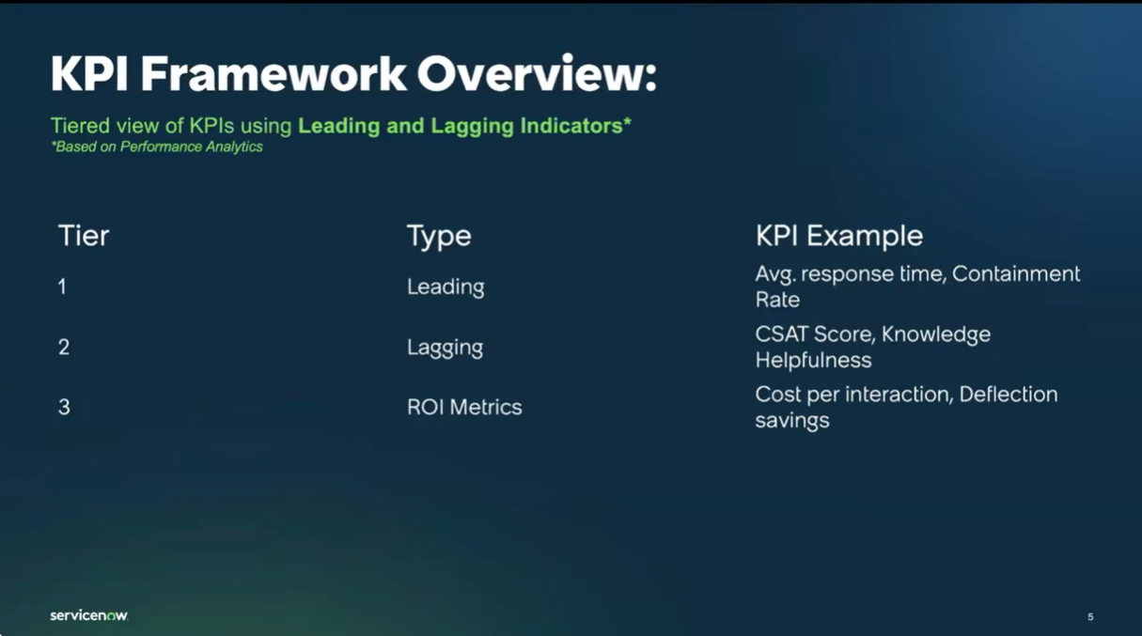

Slide 6
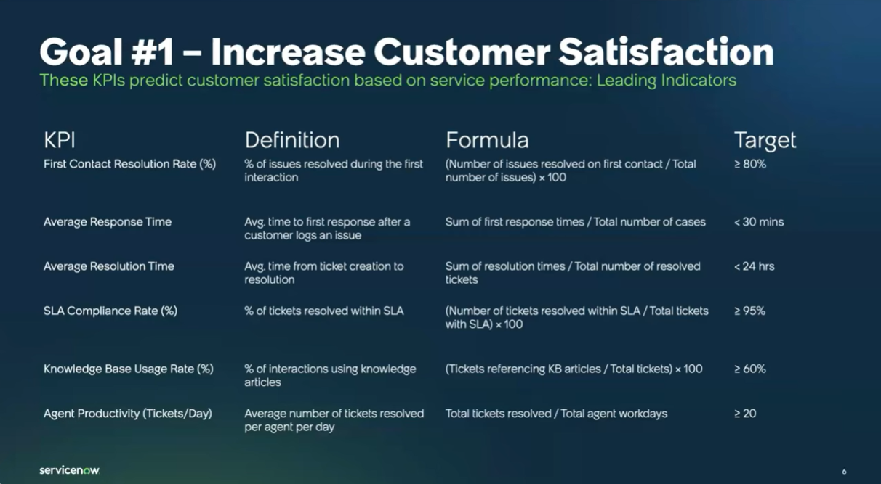

Slide 7
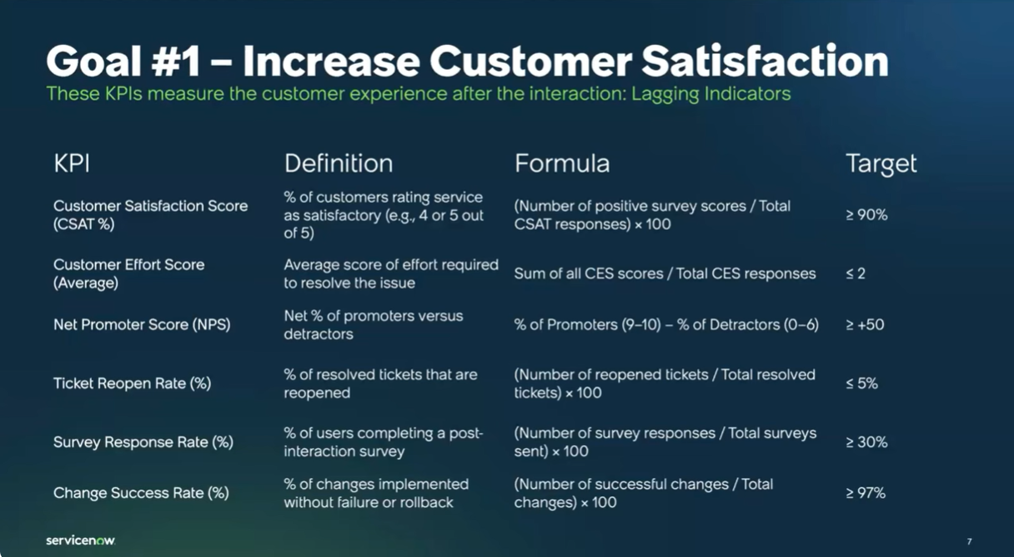

Slide 8
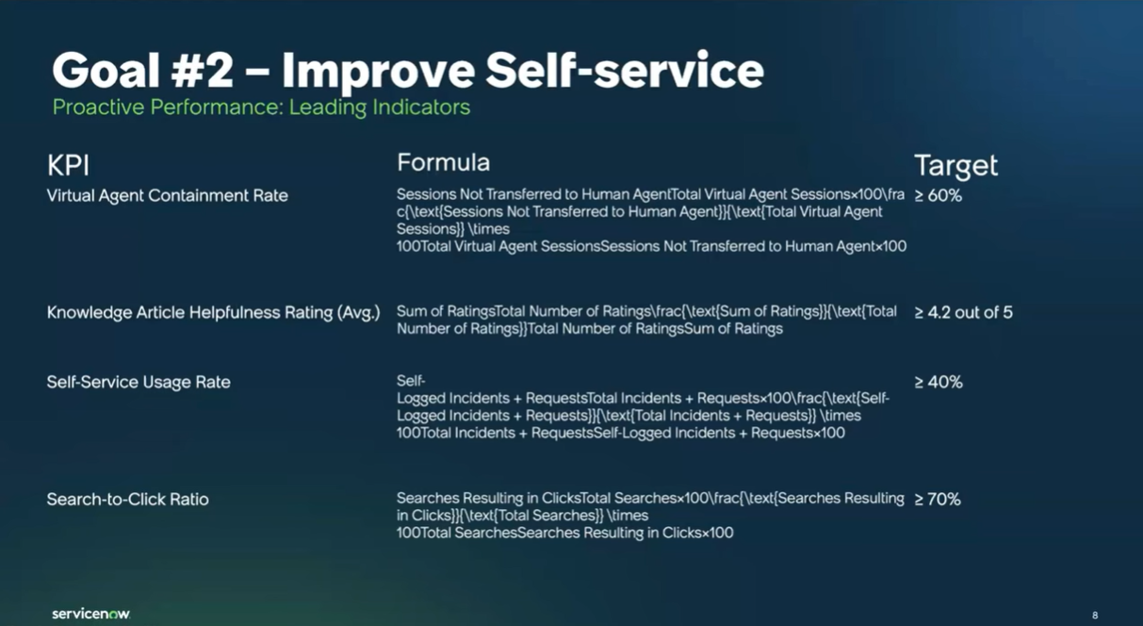

Slide 9
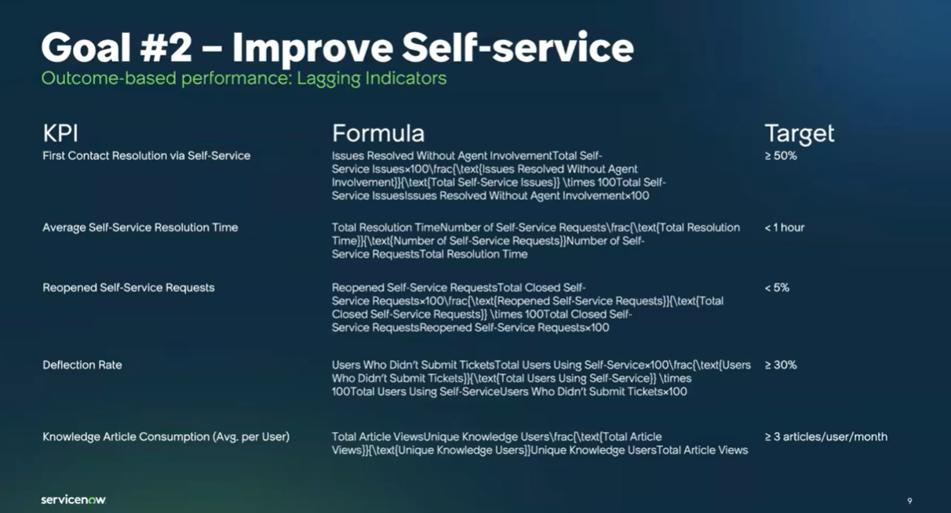

Slide 10
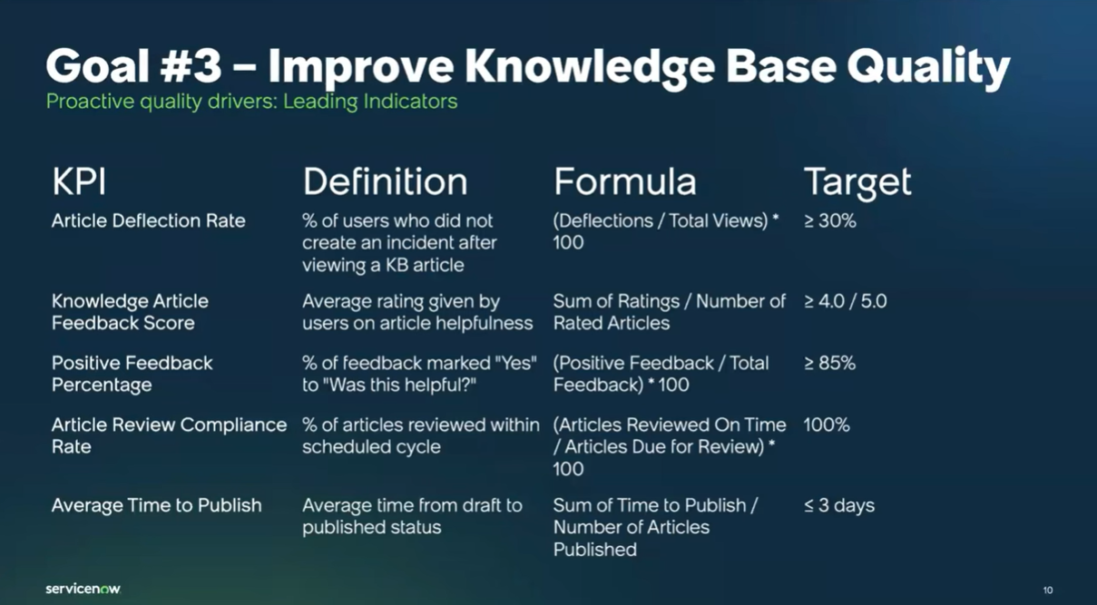

Slide 11
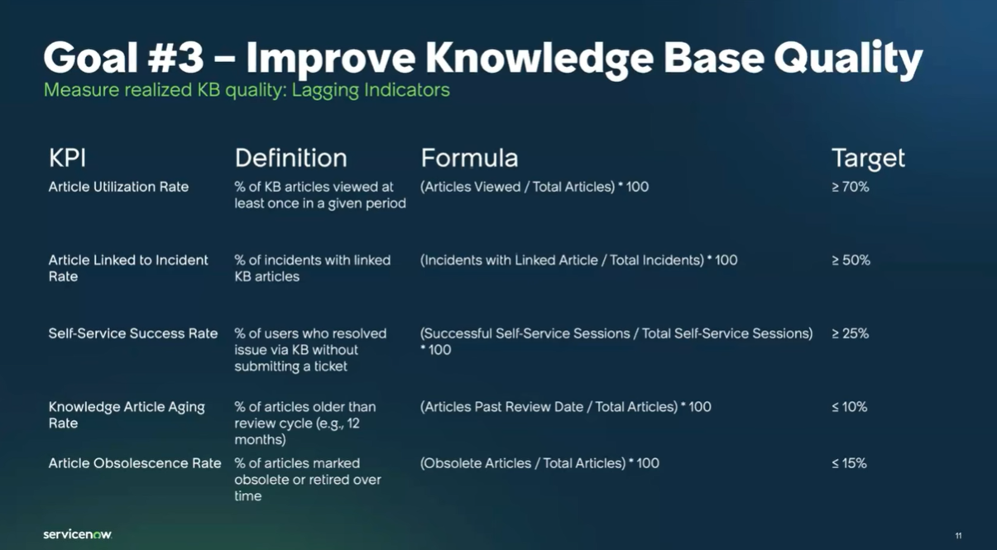

Slide 12
Boeing assessment
Business Goals | Now Assist Capability | Primary Outcome

Slide 13
Boeing assessment (cont'd)
Business Goals | Now Assist Capability | Primary Outcome

Slide 15
Next Steps
Coordinated instance and access plan
Upcoming Workshops
Demoing Phoebe and Elara (NR Agents)
Integrations Evaluation and Recommendations
Stories refinement and sign off
Boeing AI Roadmap Maturation (schedule later)
Create outstanding stories based on approved configuration
Review stories and provide feedback or acceptance of stories
Configuration can begin

Slide 16
REFERENCE
Now Assist Value Realization - June 25th, 2025 - Platform Analytics Academy

Slide 17


